Slide 1

Circuit 12
Child Protection Summit 2019

Slide 2
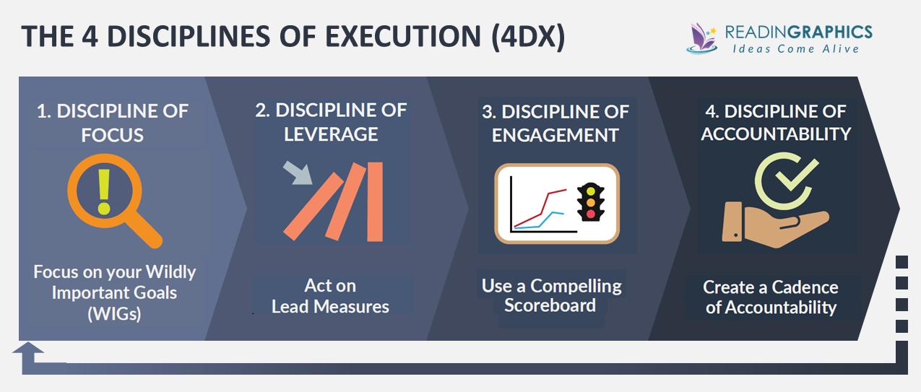

Slide 3
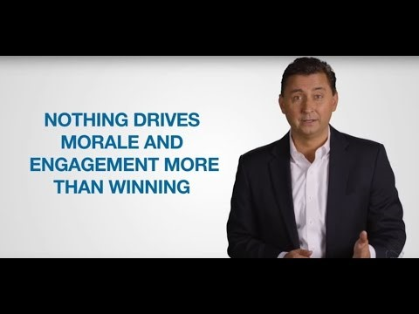
Four Disciplines of Execution

Slide 4
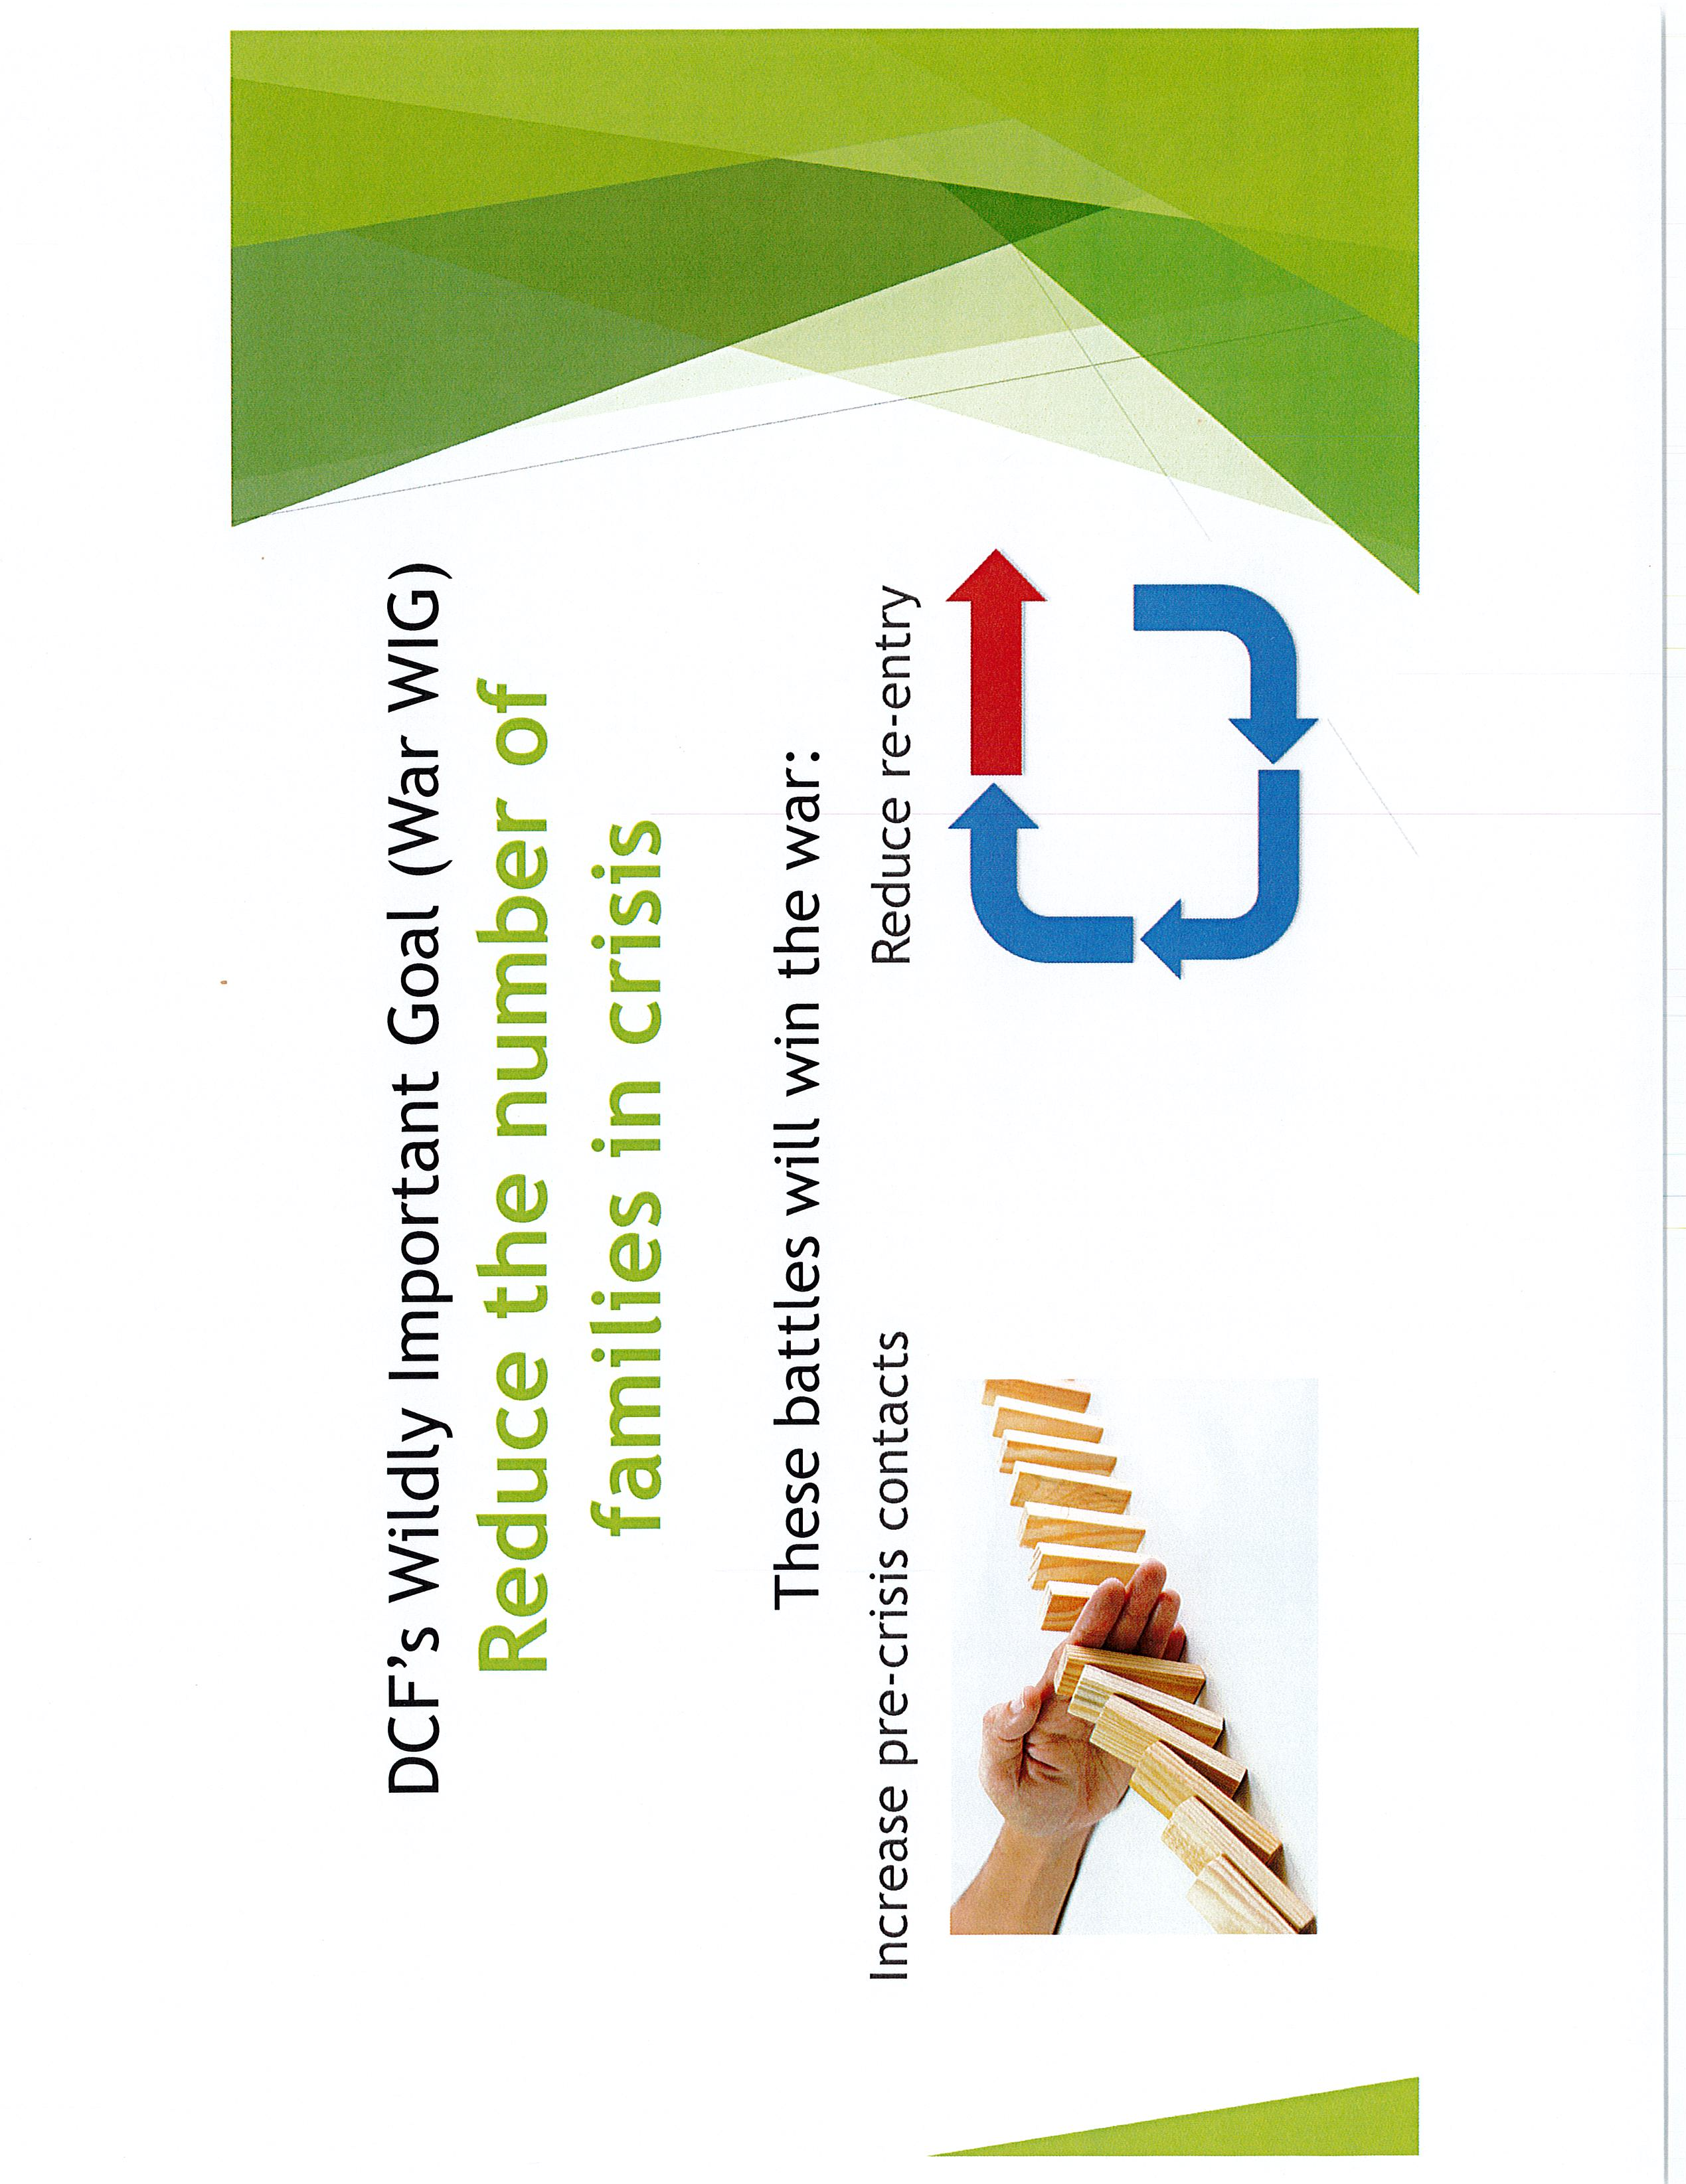
Four Disciplines of Execution

Slide 5
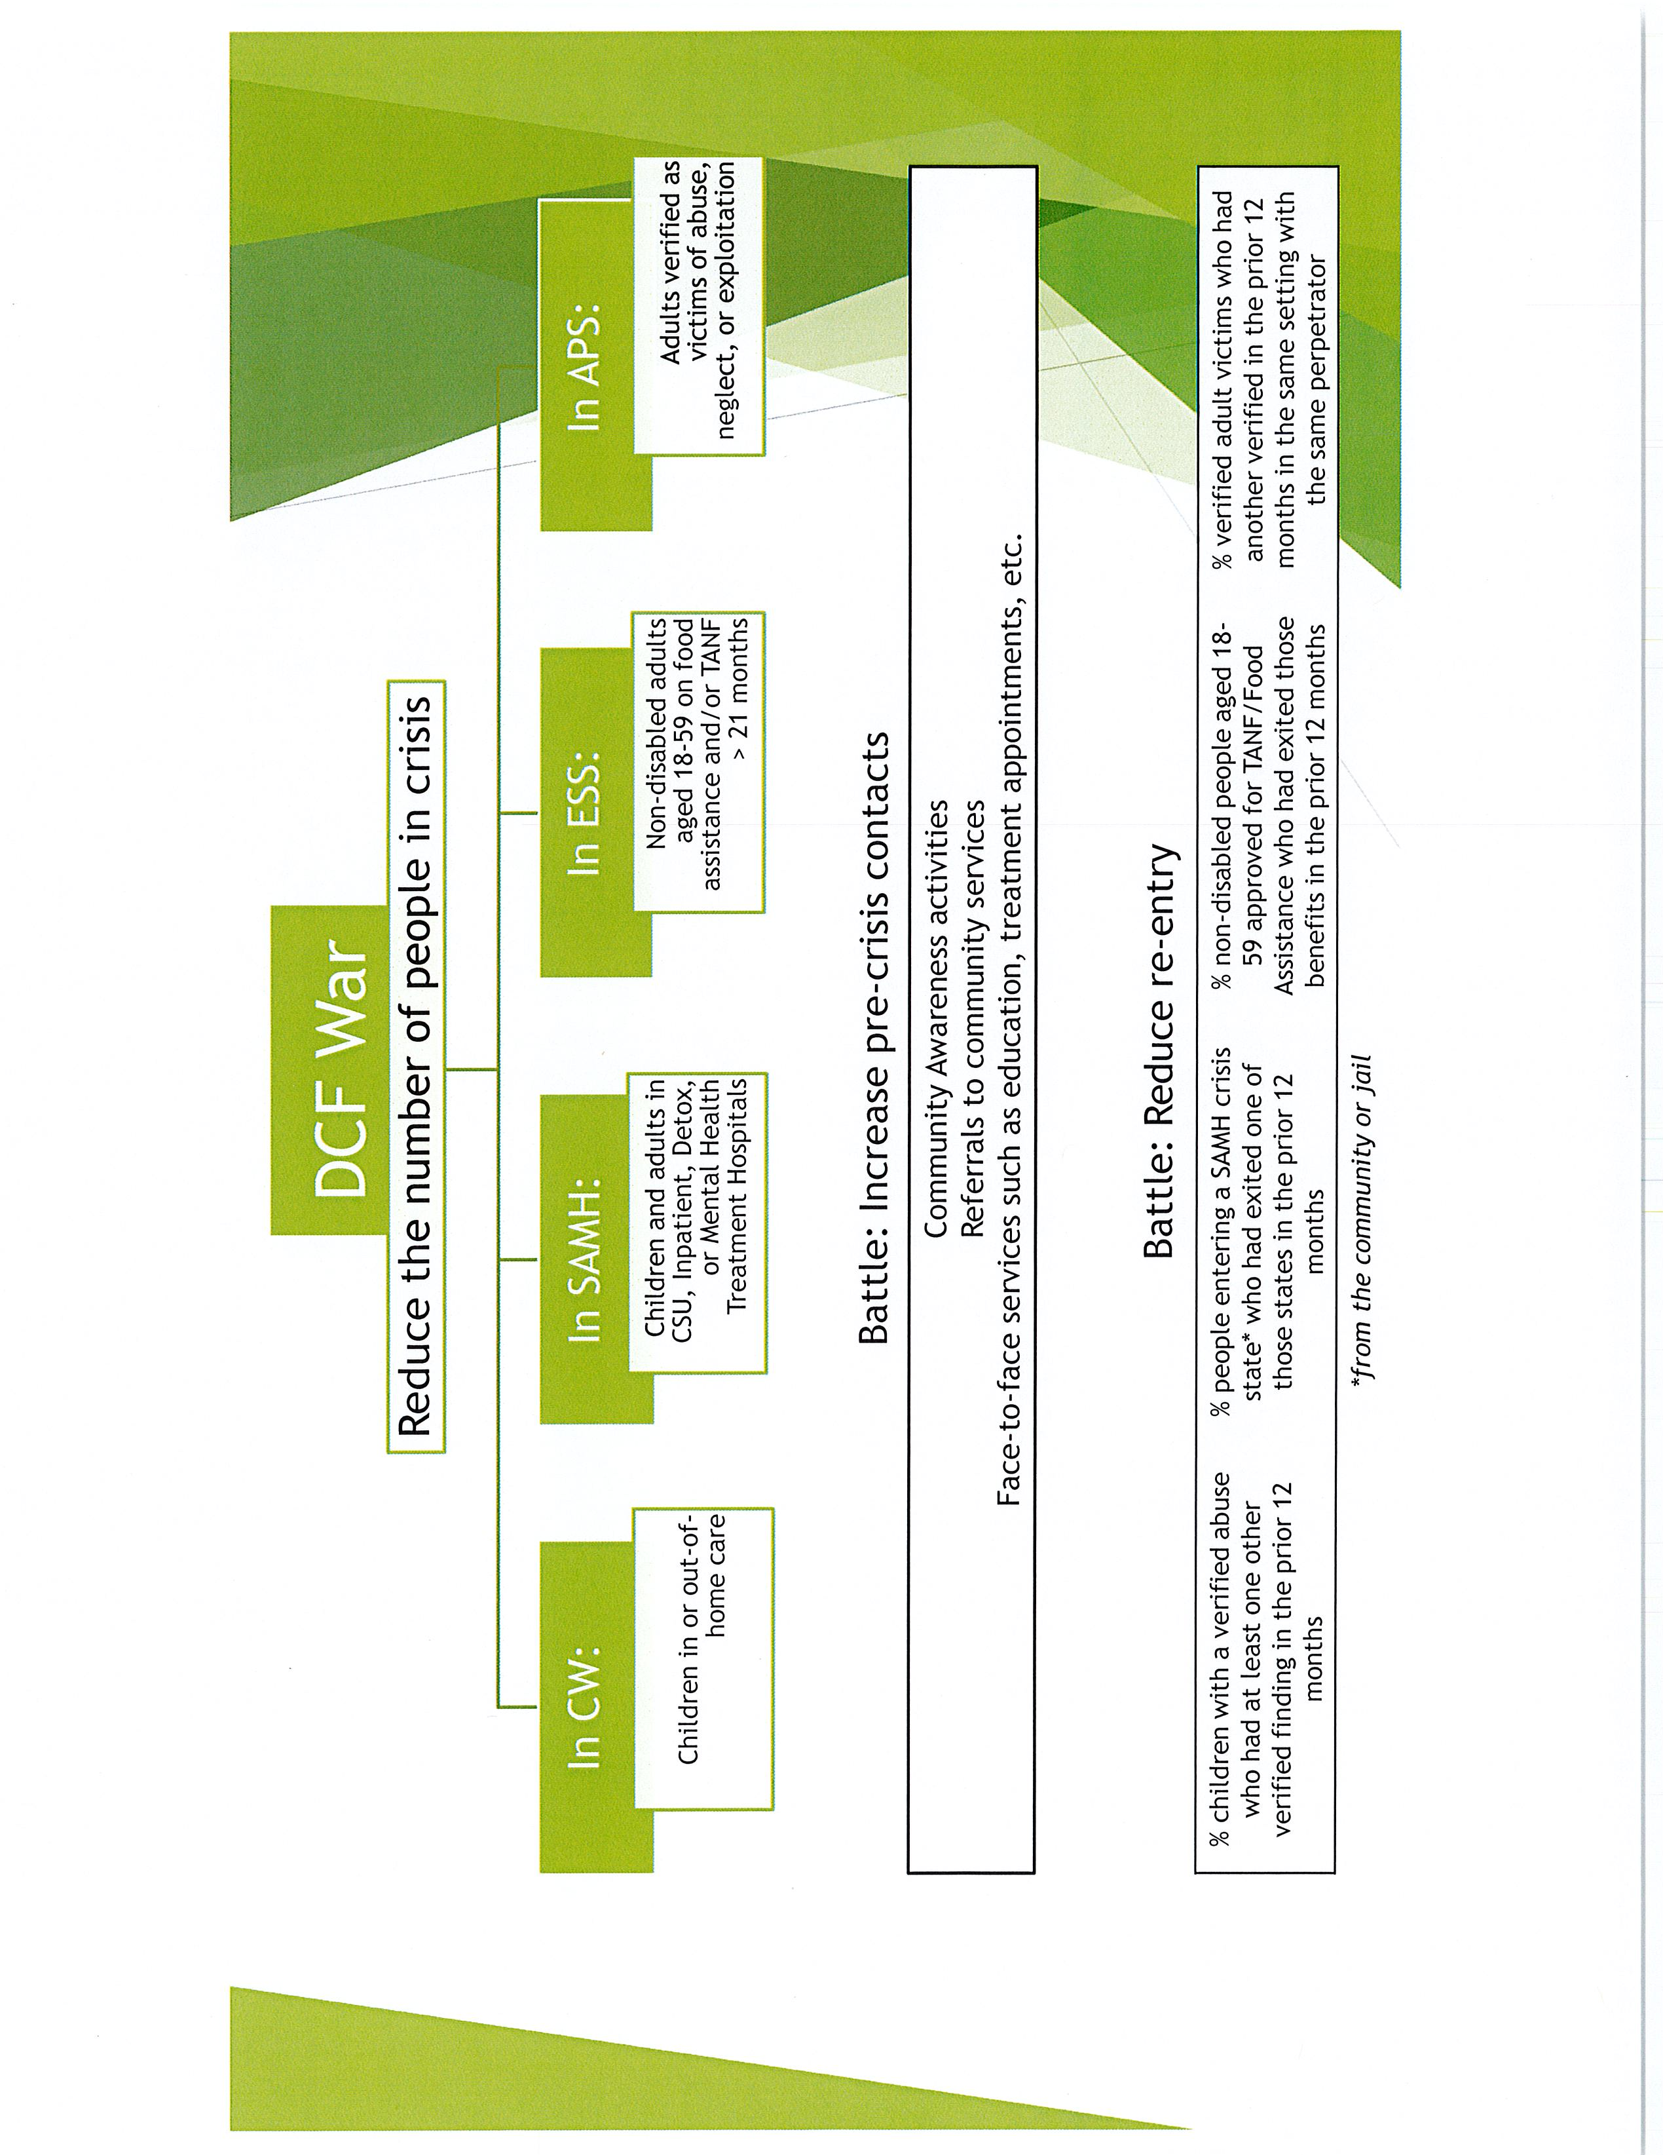
Four Disciplines of Execution

Slide 6
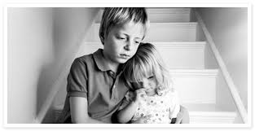


Child Welfare/SAMH
War Wigs
Reduce children in out of home care by 10%
Reduce children & adults in CSU, Inpatient, & Detox by 15%
Goal – June 2021

Slide 7
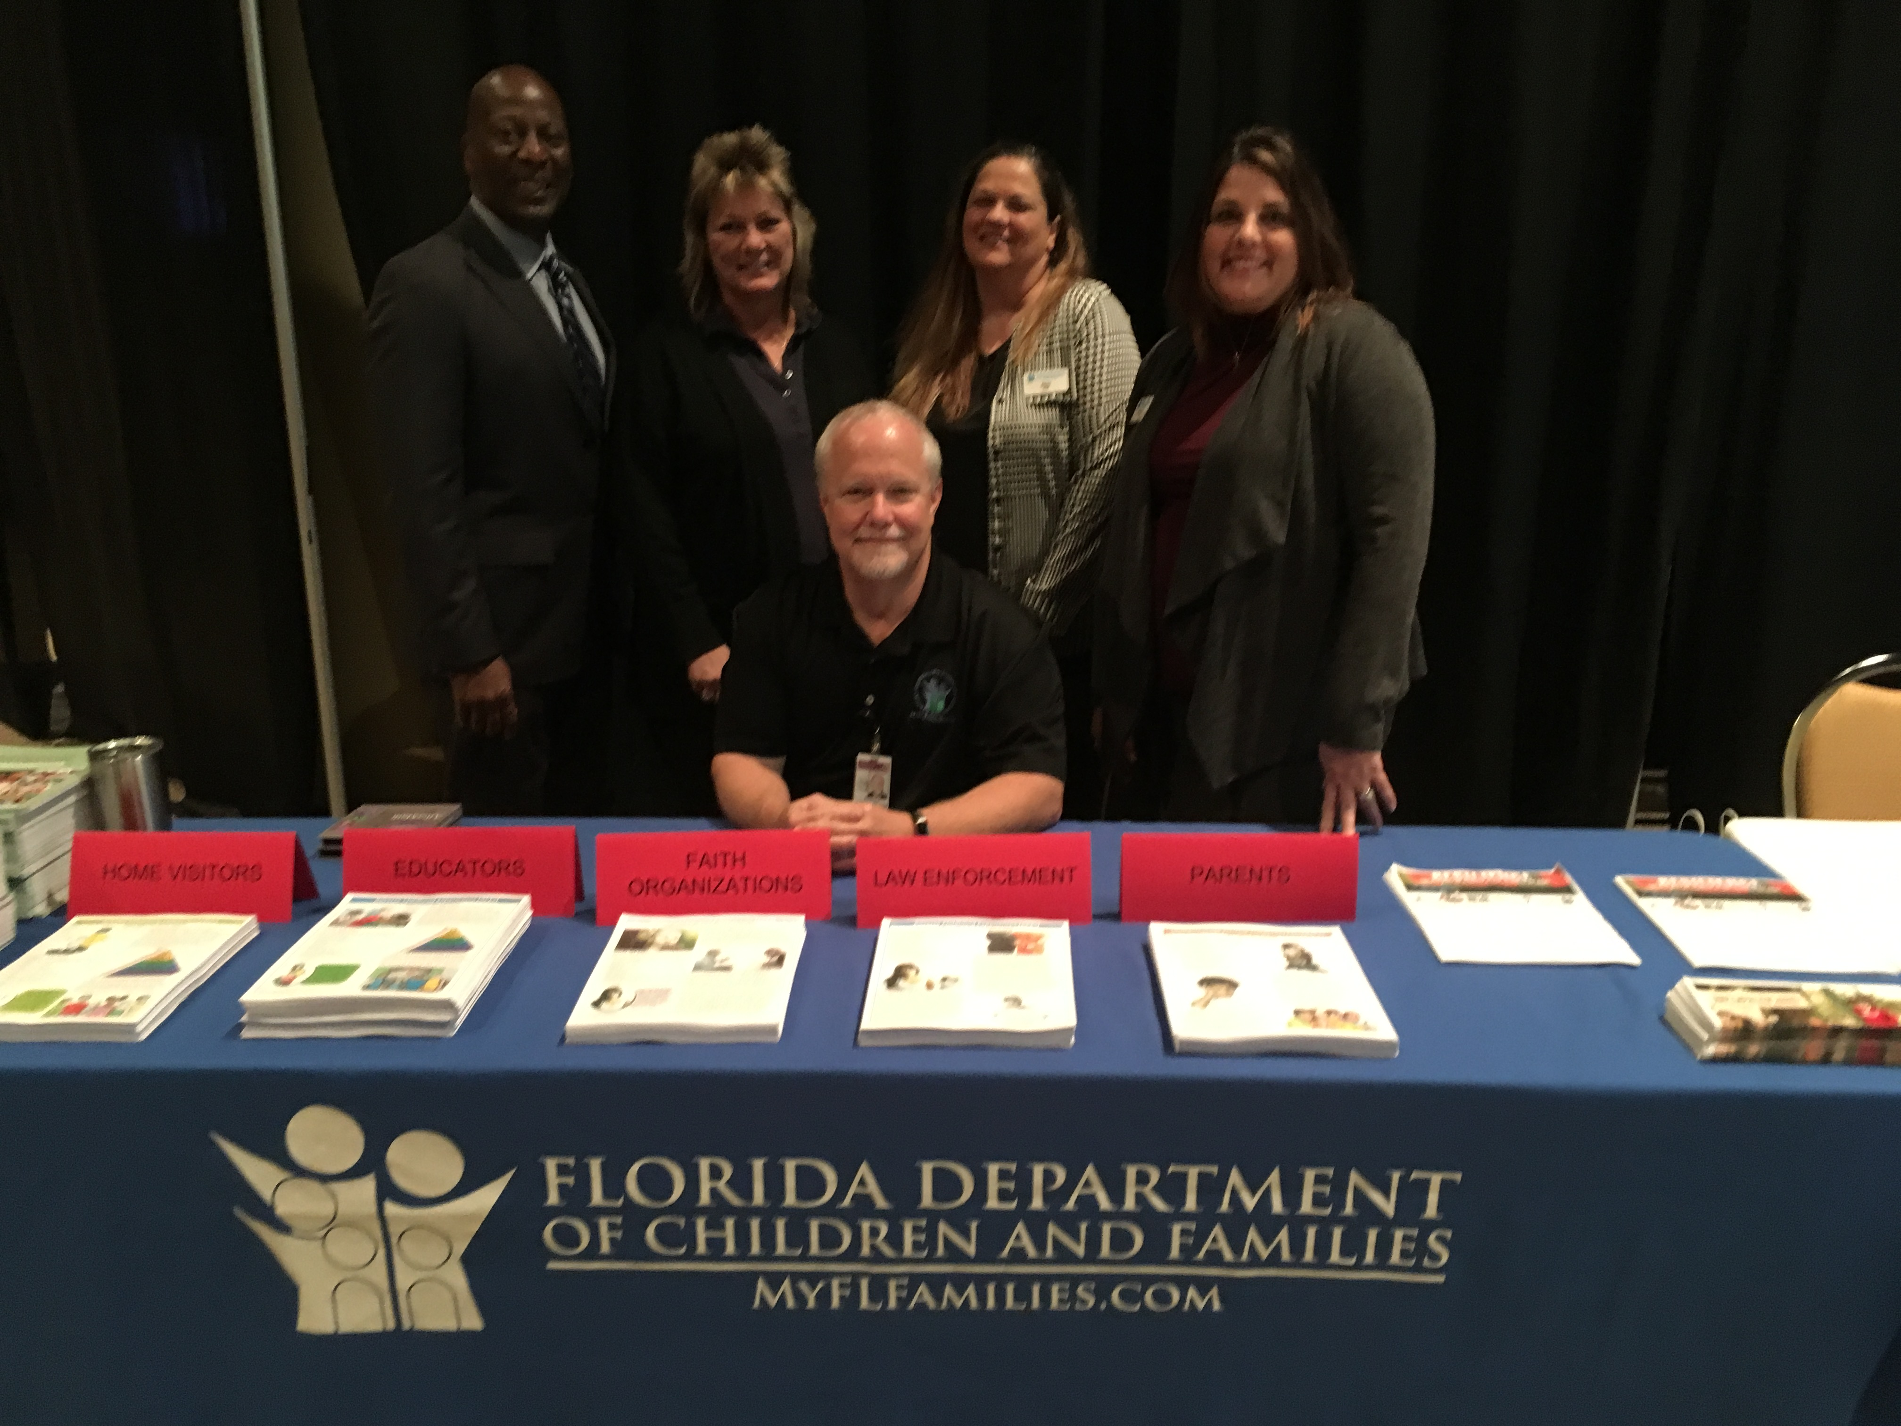
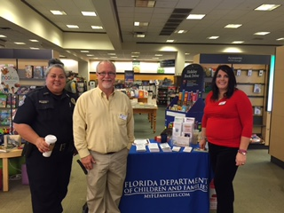
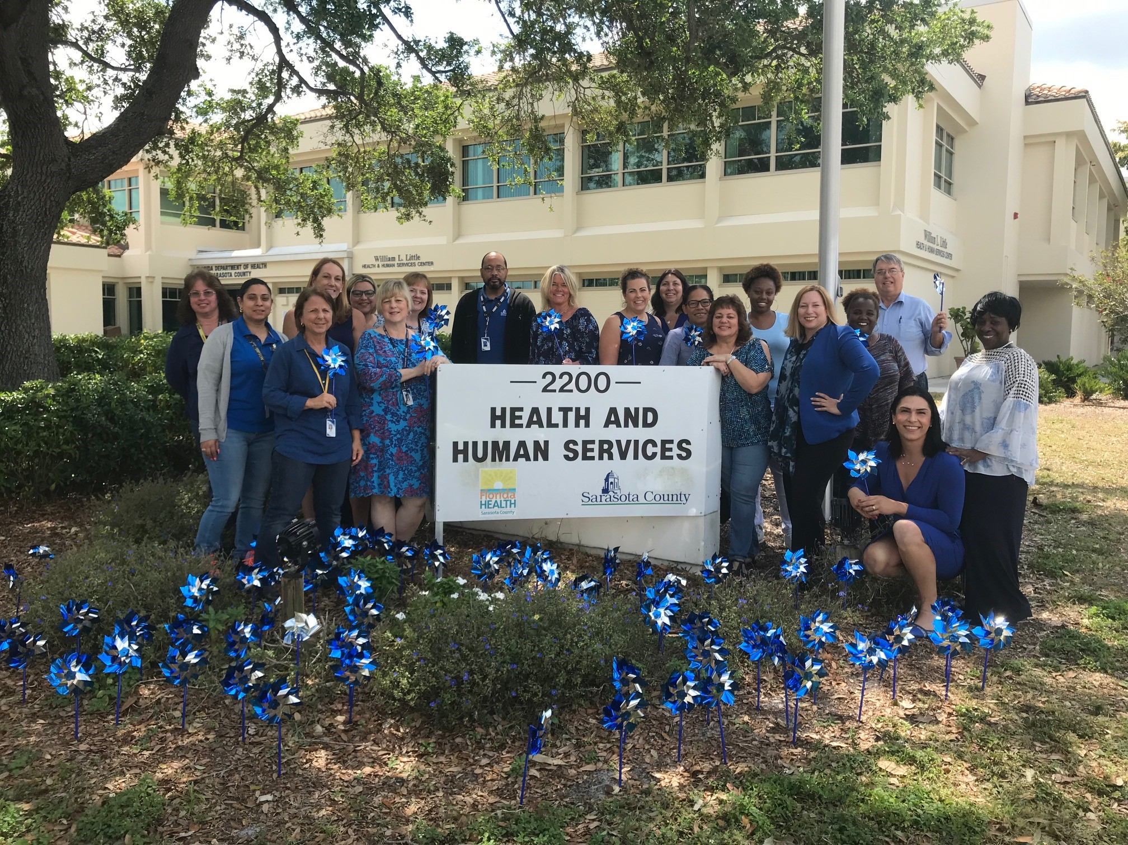
Child Welfare/SAMH
Battle Wigs
Increase pre-crisis contacts
Community awareness activities
Referrals to community services
Face to Face services: education, treatment, etc
Goal – June 2021

Slide 8



Child Welfare/SAMH
Battle Wigs
% of children with verified abuse who had at least one other verified finding in the prior 12 months – Goal is 3% (baseline 7.4%)
% of people entering SAMH crisis state who had exited one of those states in the prior 12 months – Goal is 10% (baseline 20.7%)
Goal – June 2021

Slide 9
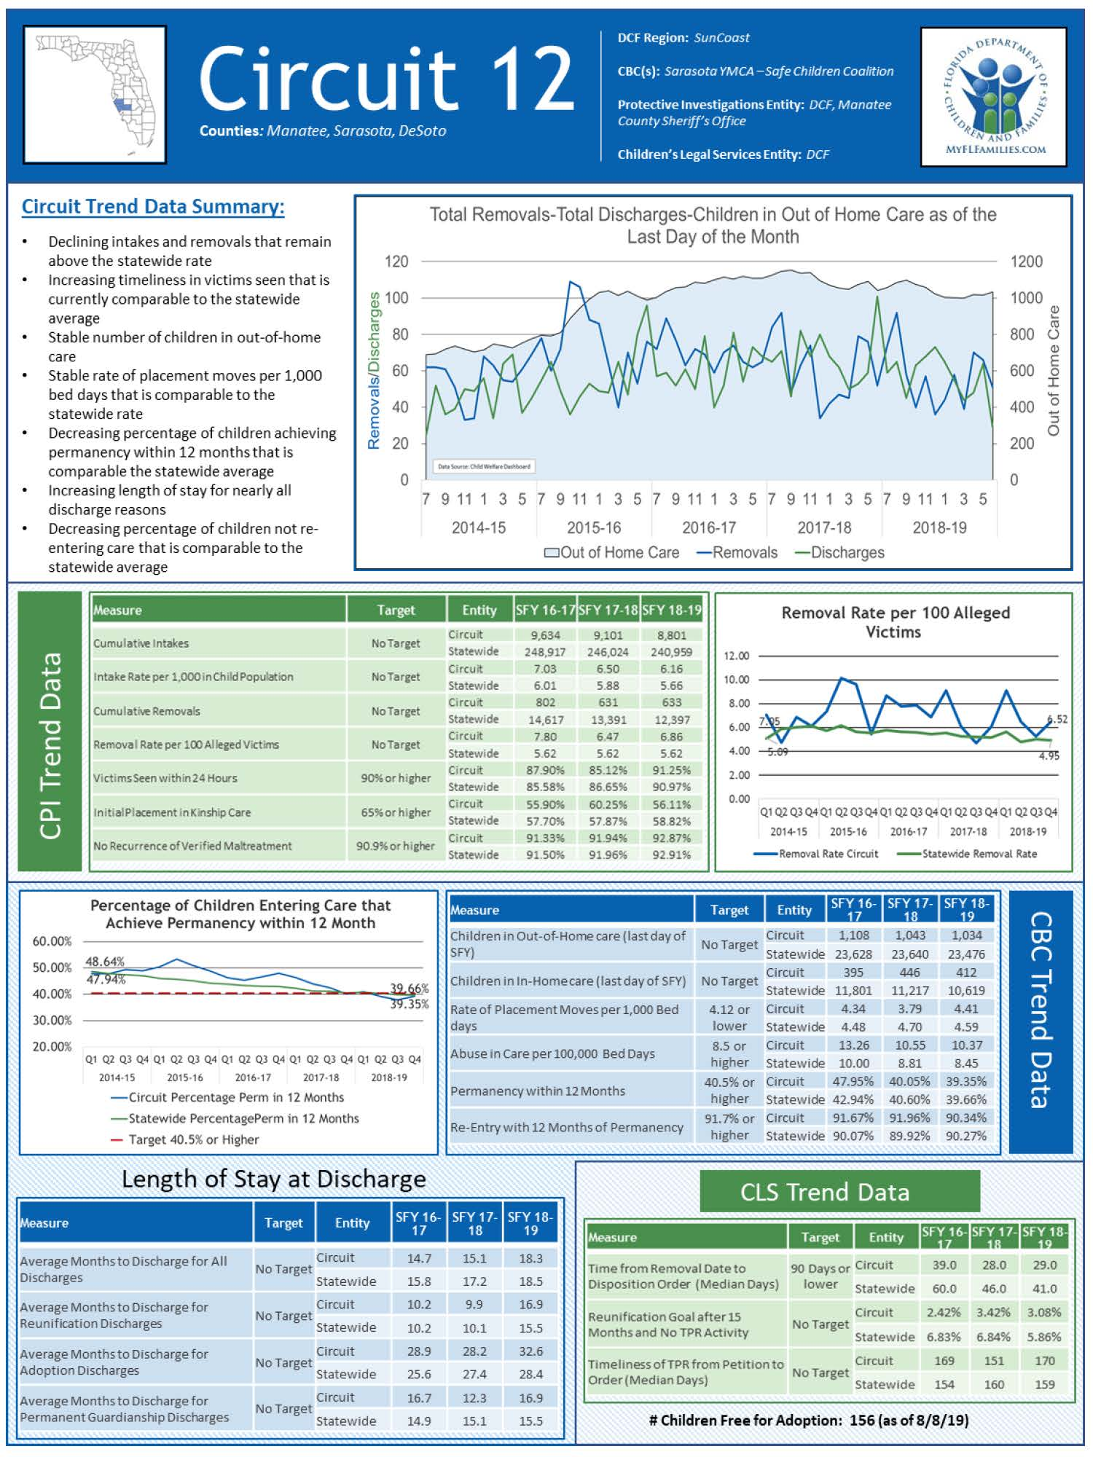

Slide 10


Slide 11
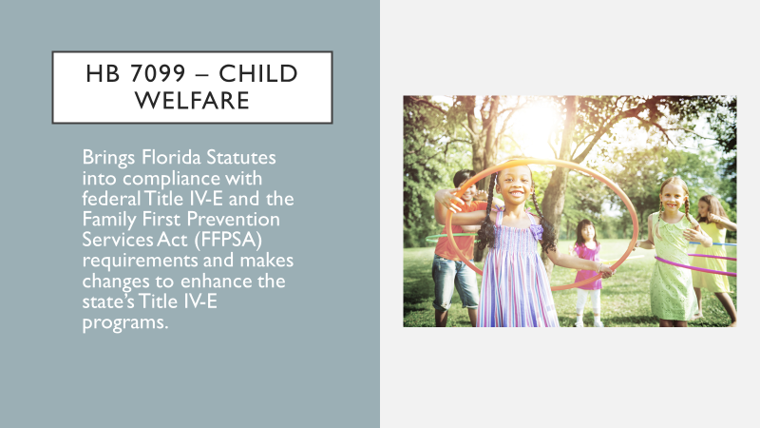

Slide 12
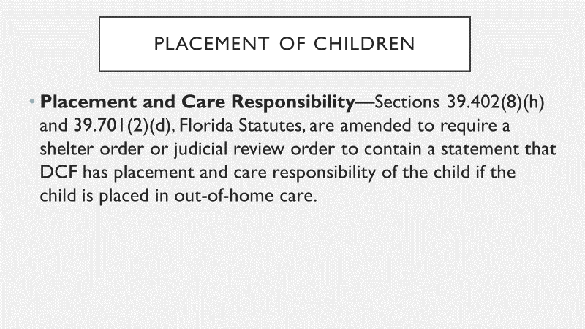

Slide 13
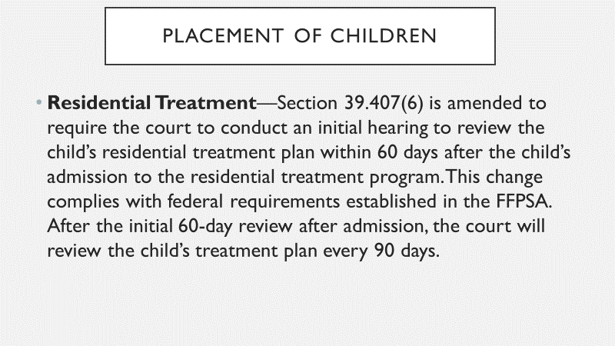

Slide 14
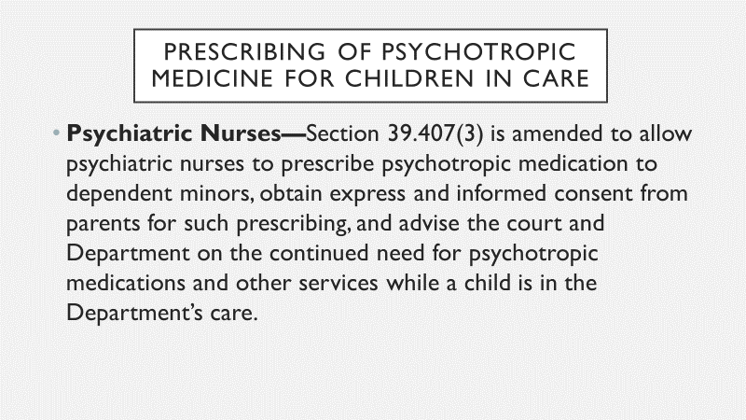

Slide 15
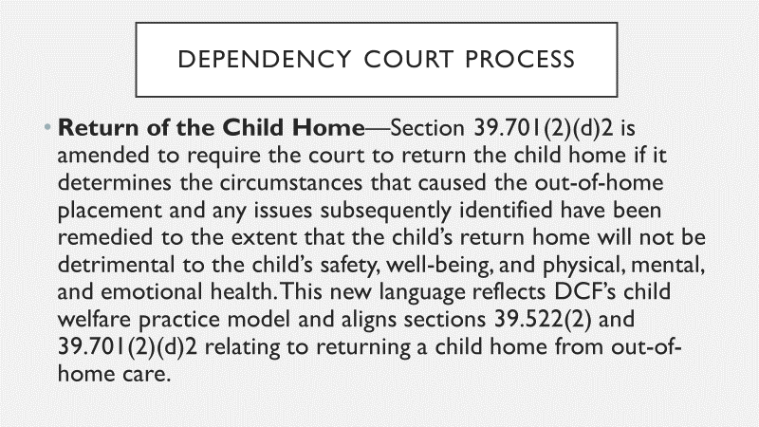

Slide 16
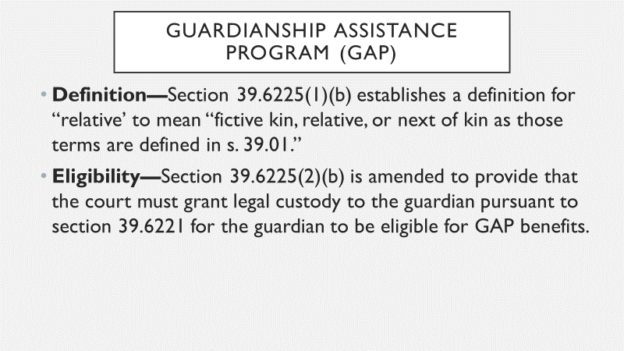

Slide 17
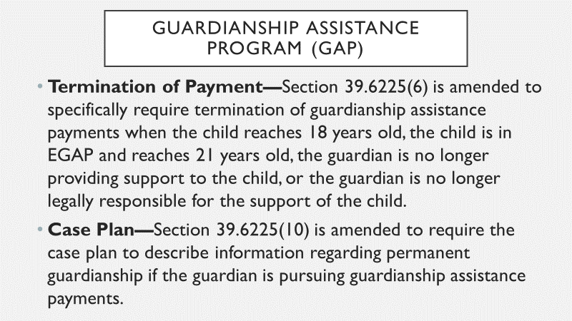

Slide 18
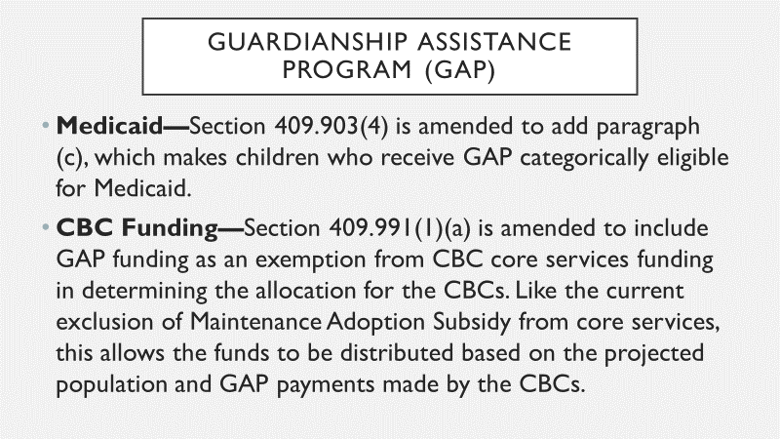

Slide 19
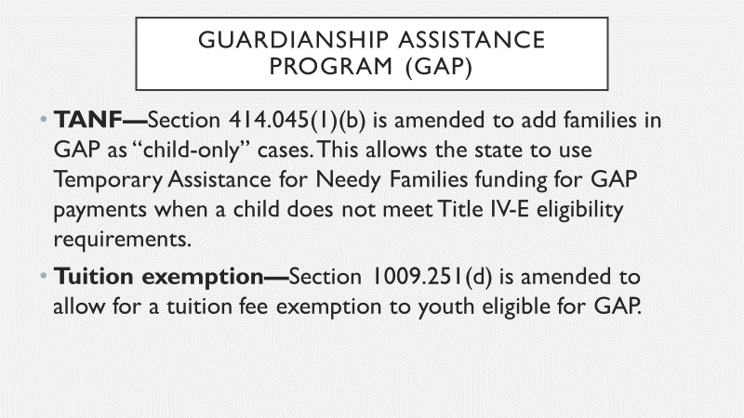

Slide 20
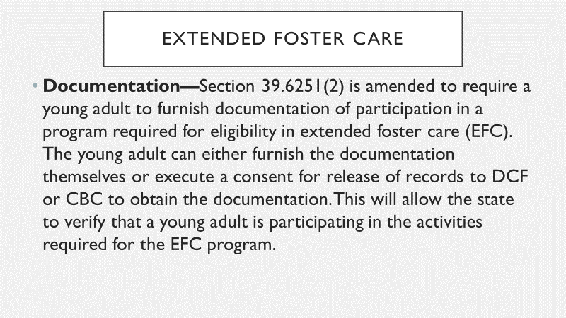

Slide 21
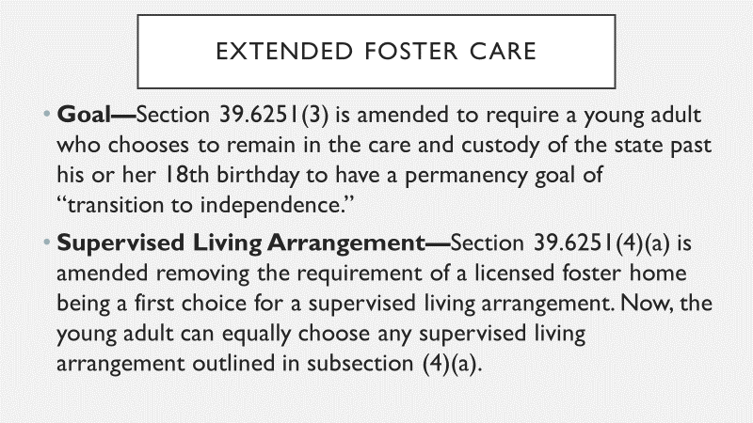

Slide 22
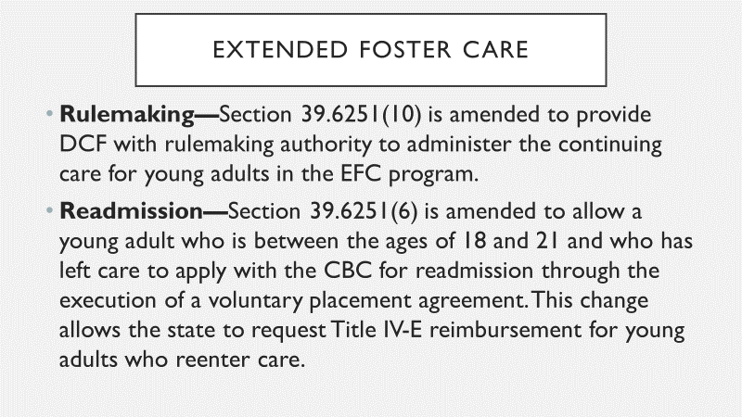

Slide 23
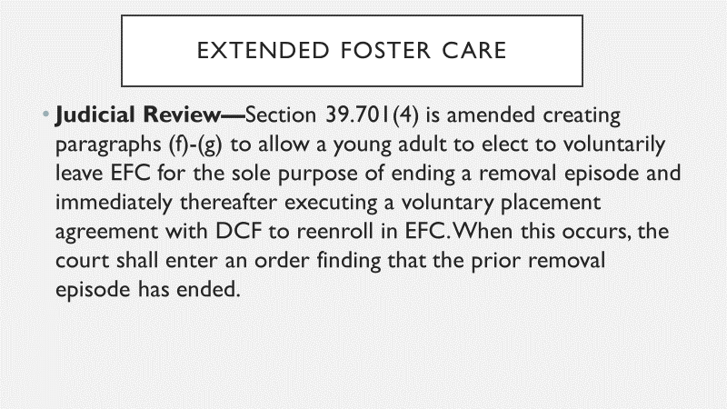

Slide 24
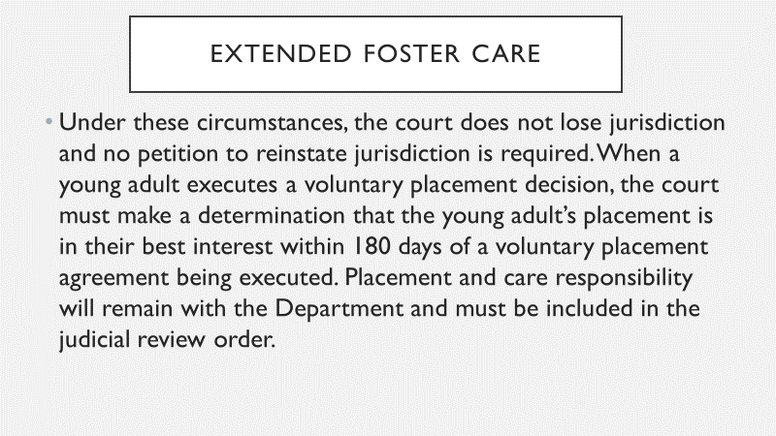

Slide 25
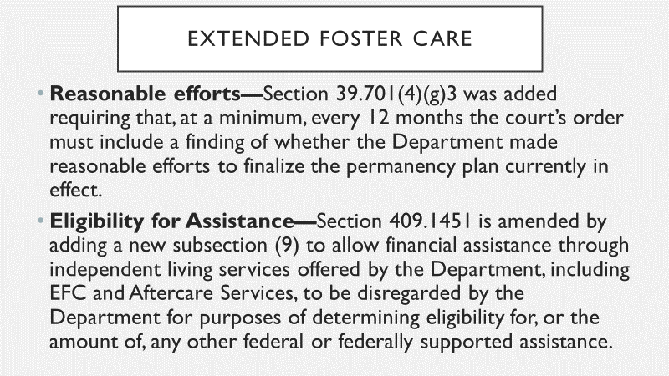

Slide 26
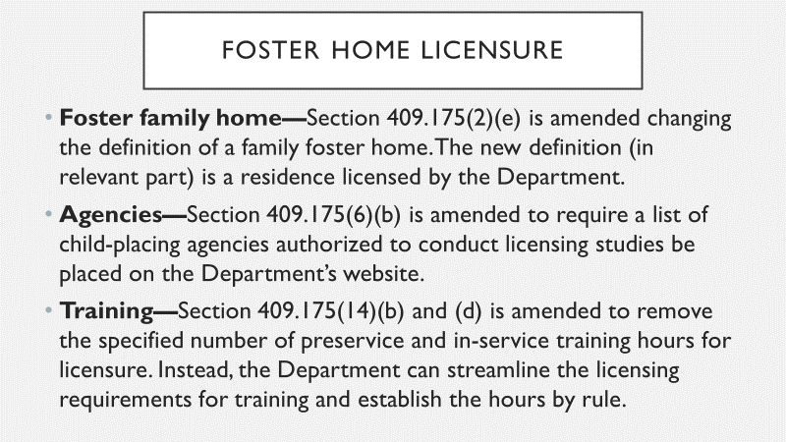

Slide 27
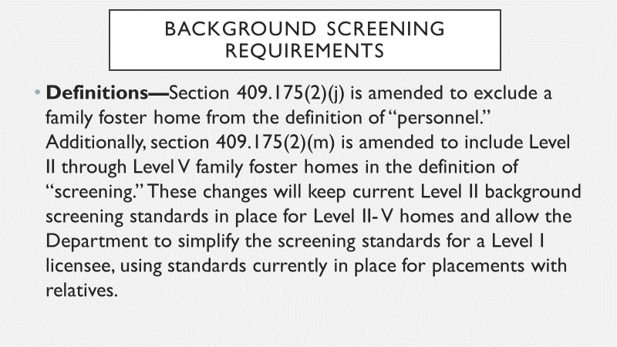

Slide 28
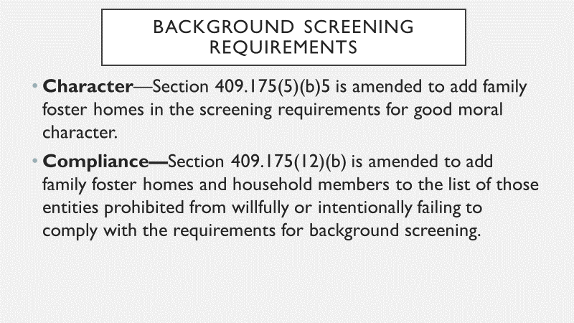

Slide 29
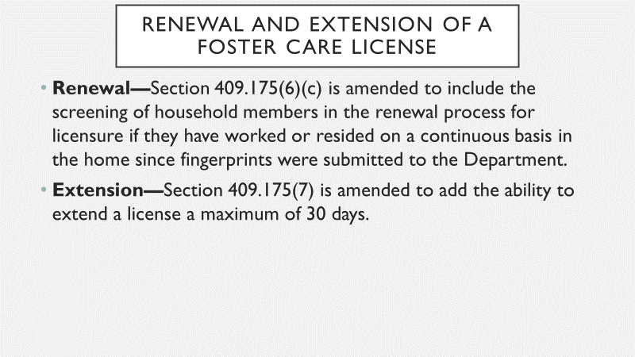

Slide 30
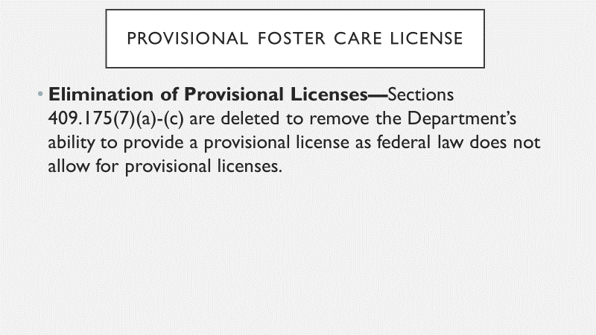

Slide 31
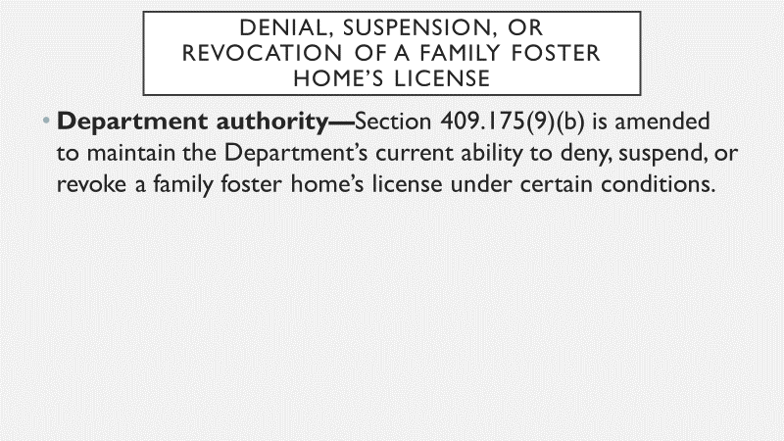

Slide 32
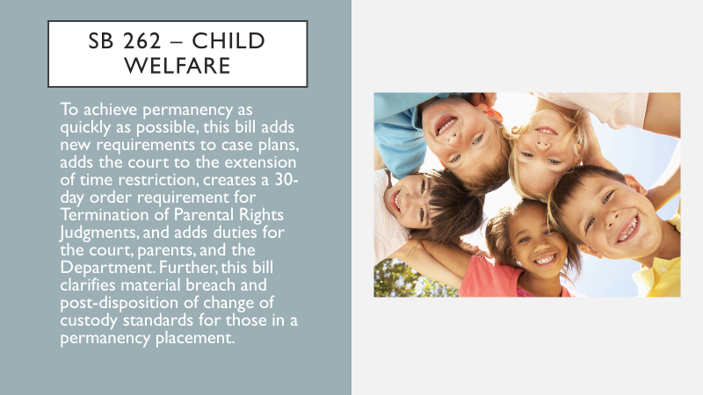

Slide 33
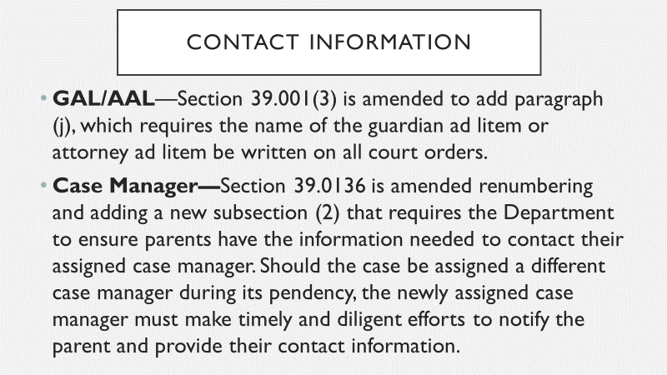

Slide 34
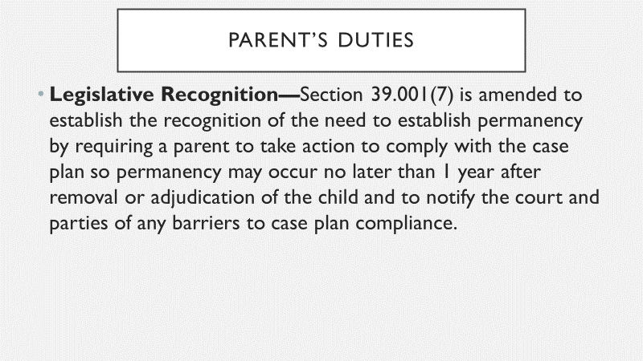

Slide 35
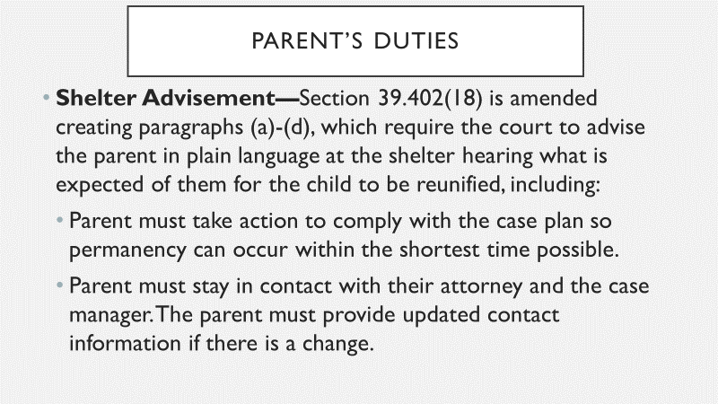

Slide 36
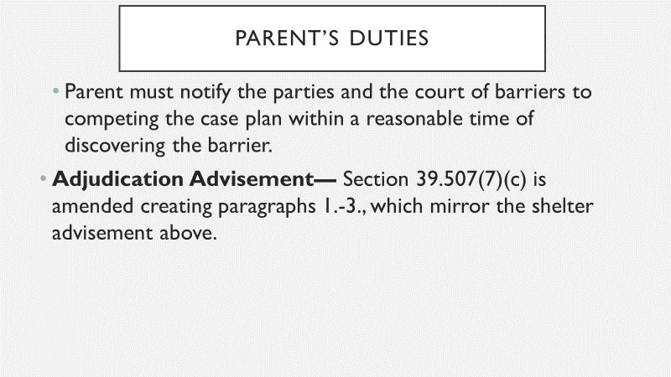

Slide 37
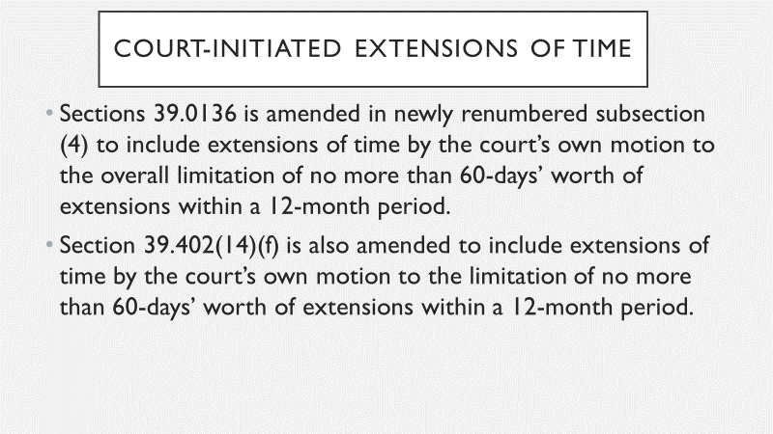

Slide 38
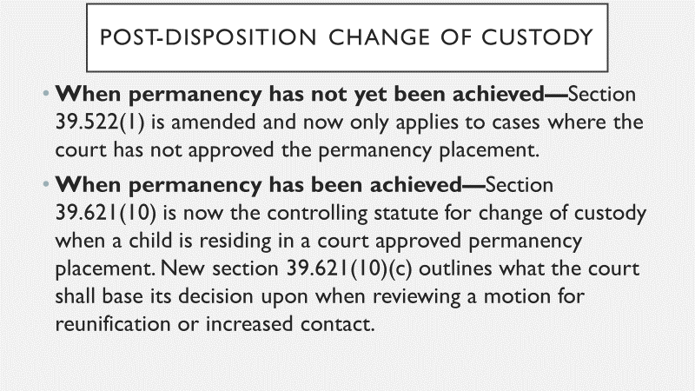

Slide 39
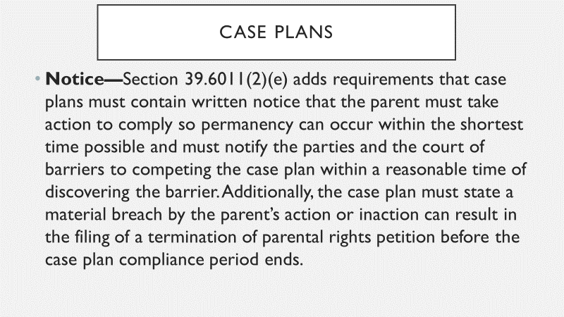

Slide 40
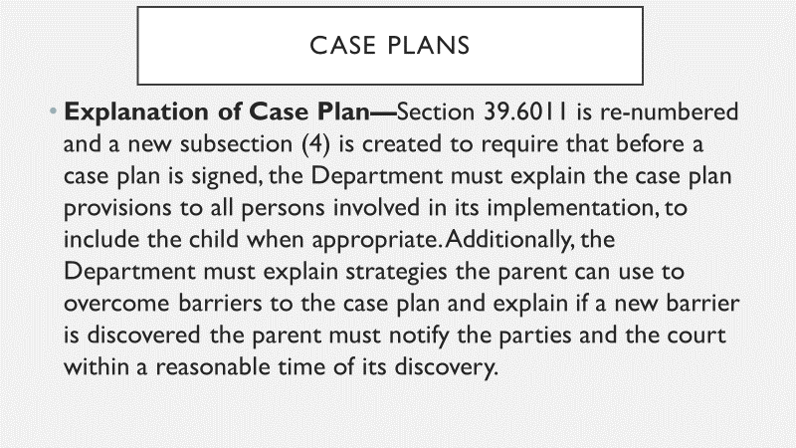

Slide 41
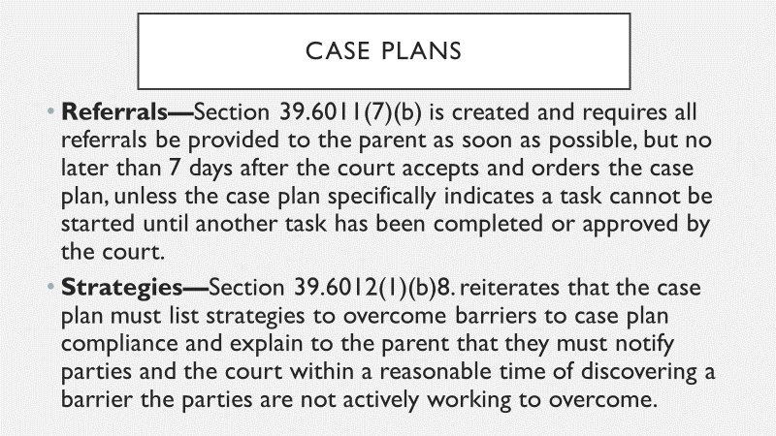

Slide 42
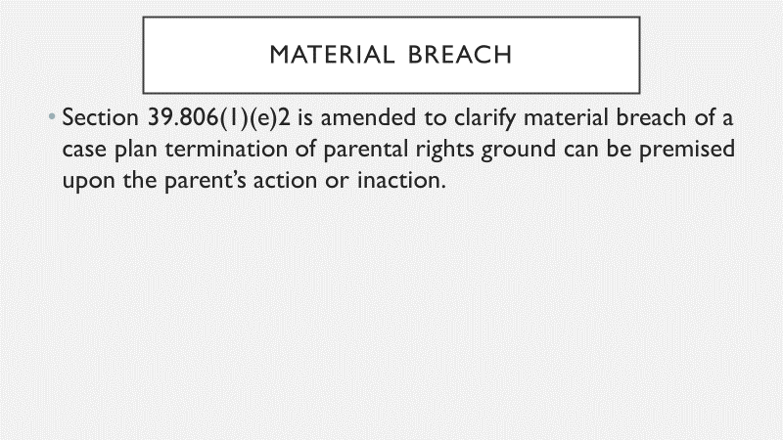

Slide 43
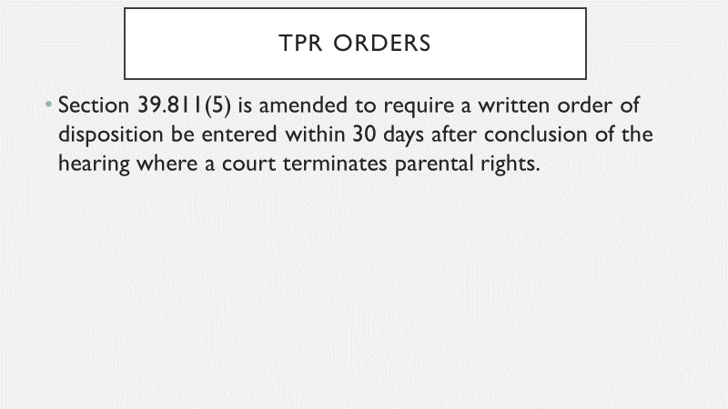

Slide 44
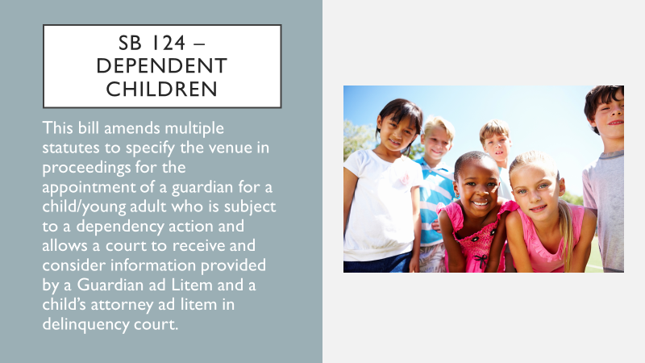

Slide 45
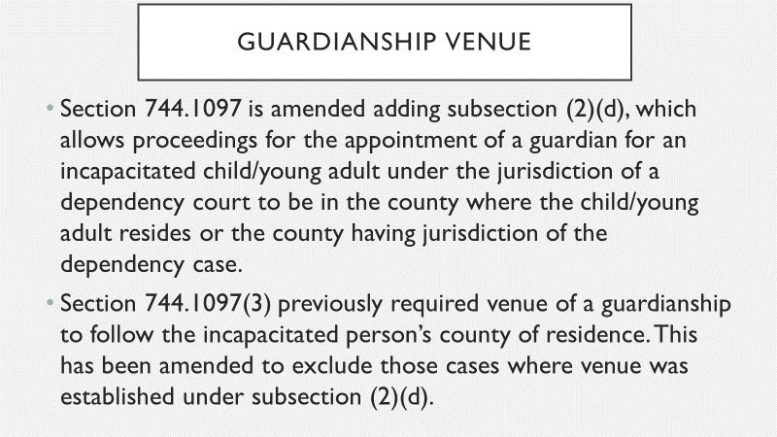

Slide 46
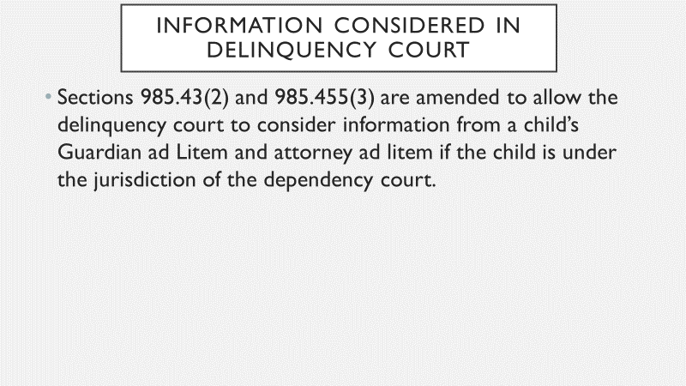

Slide 47
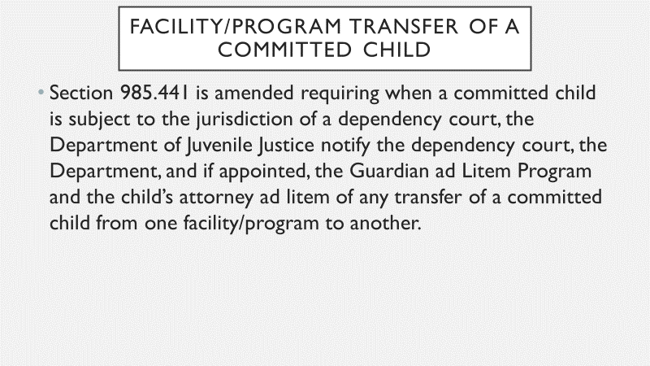

Slide 48
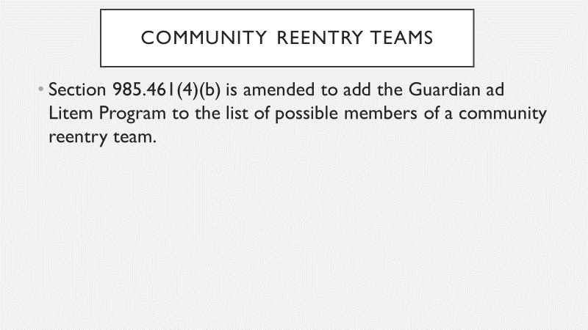

Slide 49
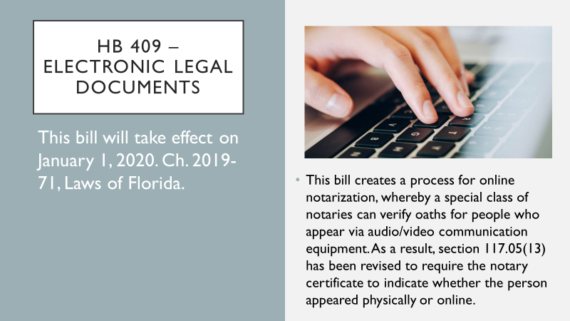

Slide 50
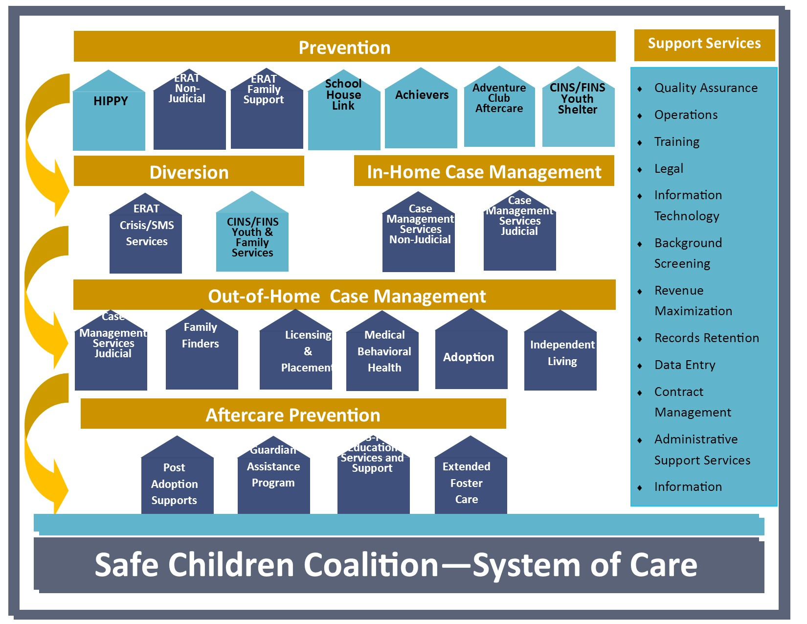

Slide 51


Slide 52


Slide 53
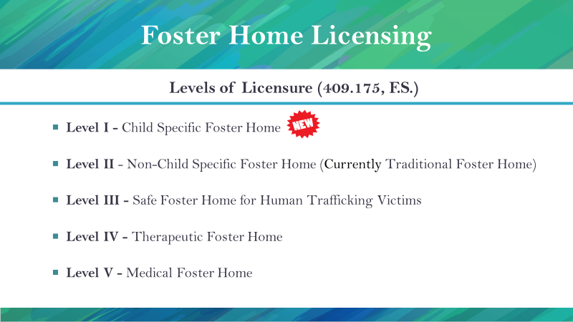

Slide 54


Slide 55


Slide 56


Slide 57


Slide 58


Slide 59


Slide 60


Slide 61


Slide 62


Slide 63


Slide 64



Slide 65
Thank you
Kimberly Kutch, DCF SCR Circuit 12 Community Development Administrator
David Silverstein, DCF SCR Circuit 12 Managing Attorney
Brena Slater, Safe Children’s Coalition Senior Vice President
Kathleen Cowan, Safe Children’s Coalition Vice President

